Slide 1
Artificial Intelligence: Sketches of the Far Future
Shahar Avin
Centre for the Study of Existential Risk (CSER)
University of Cambridge

Slide 2
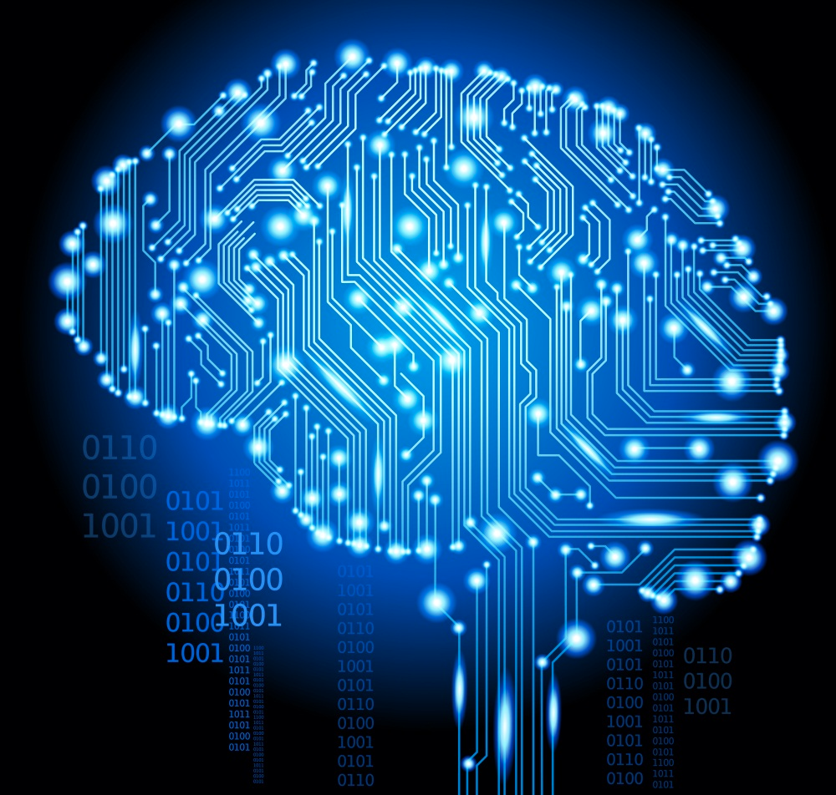
What is AI?

Slide 3
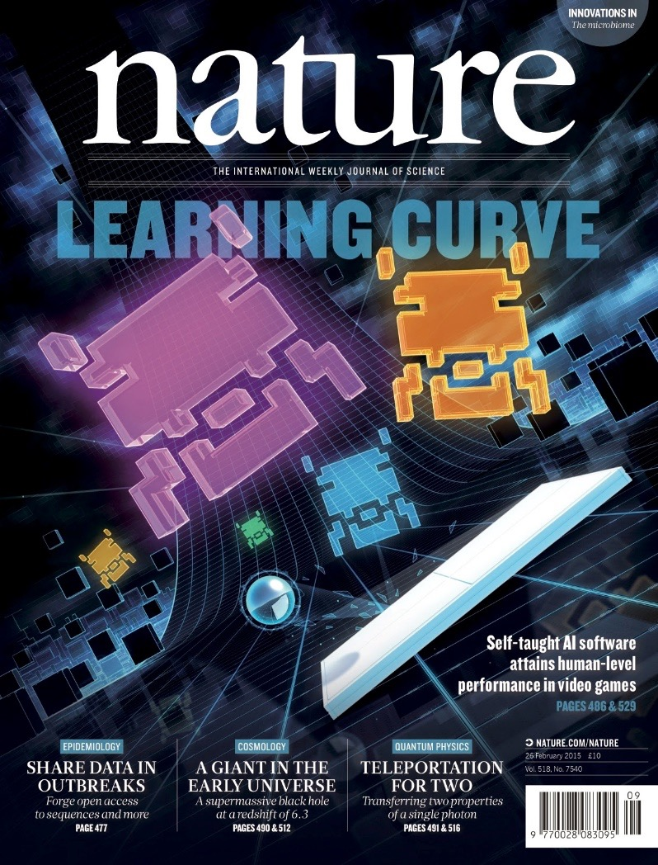
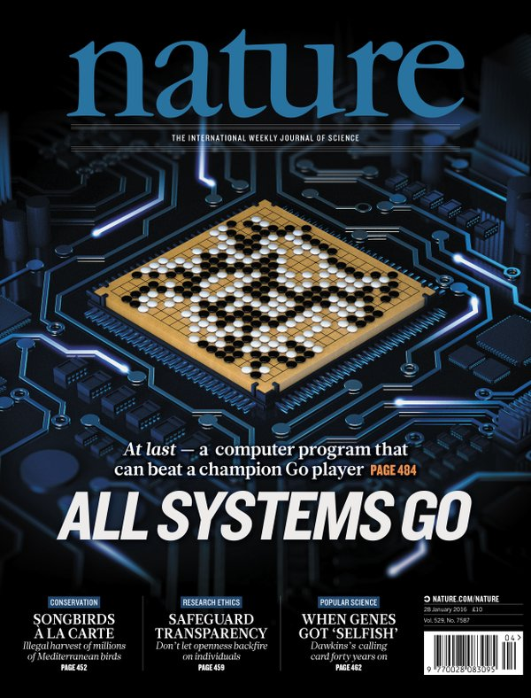
Deep Neural Networks

Slide 4

https://xkcd.com/1838/

Slide 5
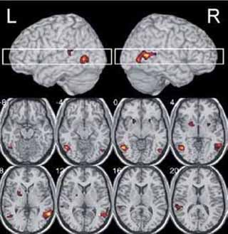
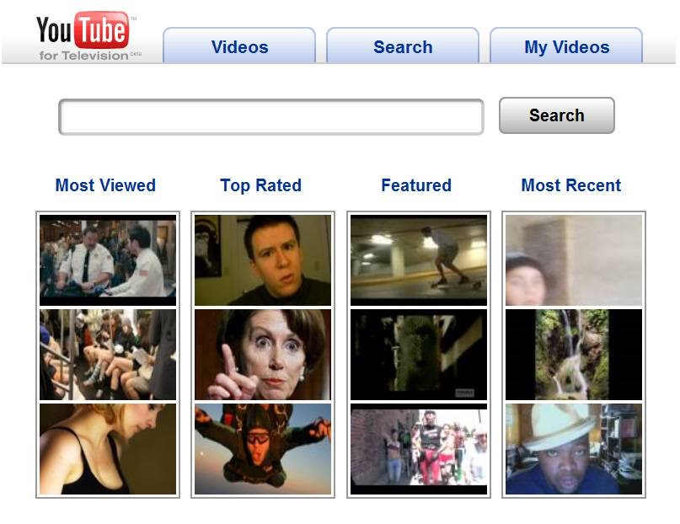
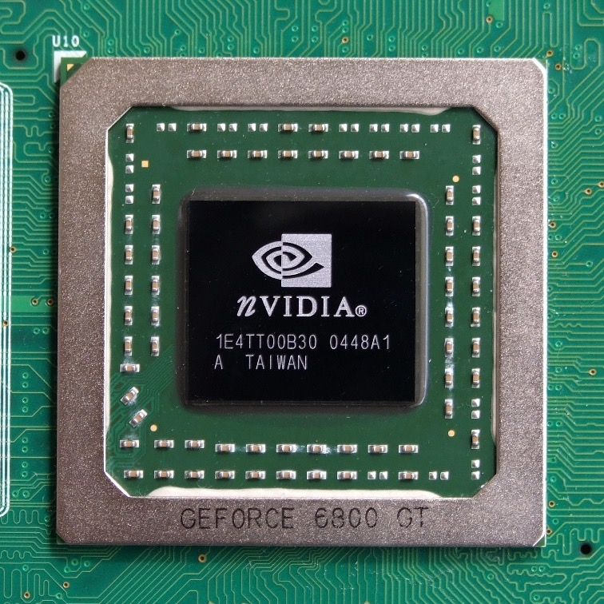
The necessary ingredients

Slide 6
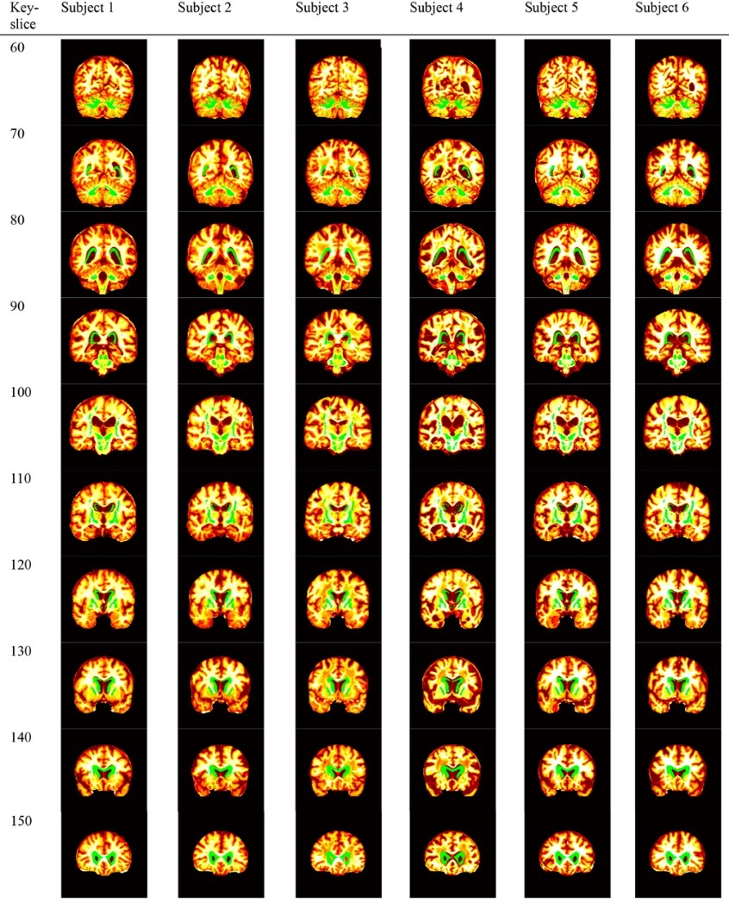
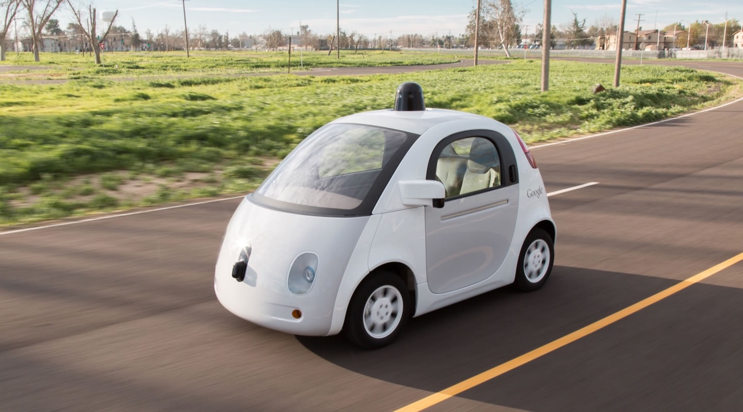
Near future

Slide 7
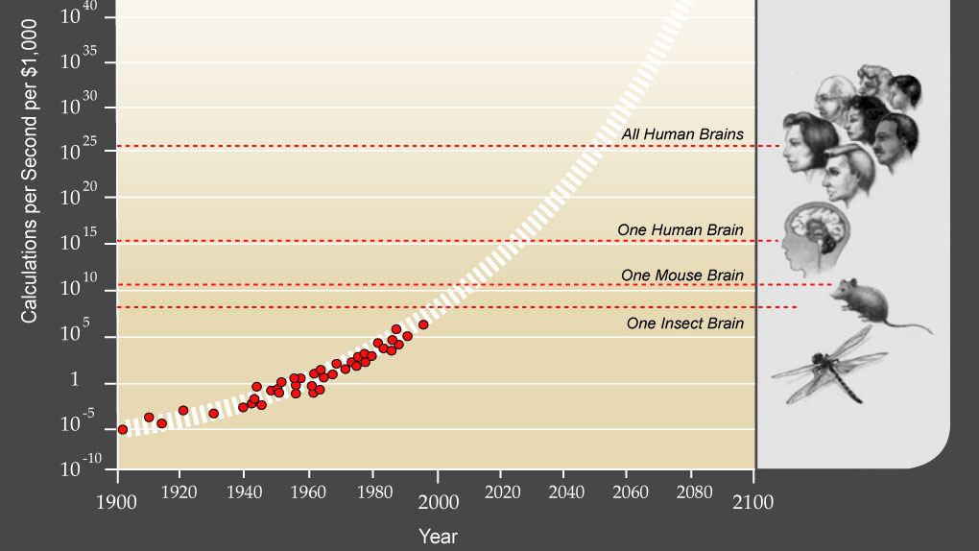
Exponential growth

Slide 8
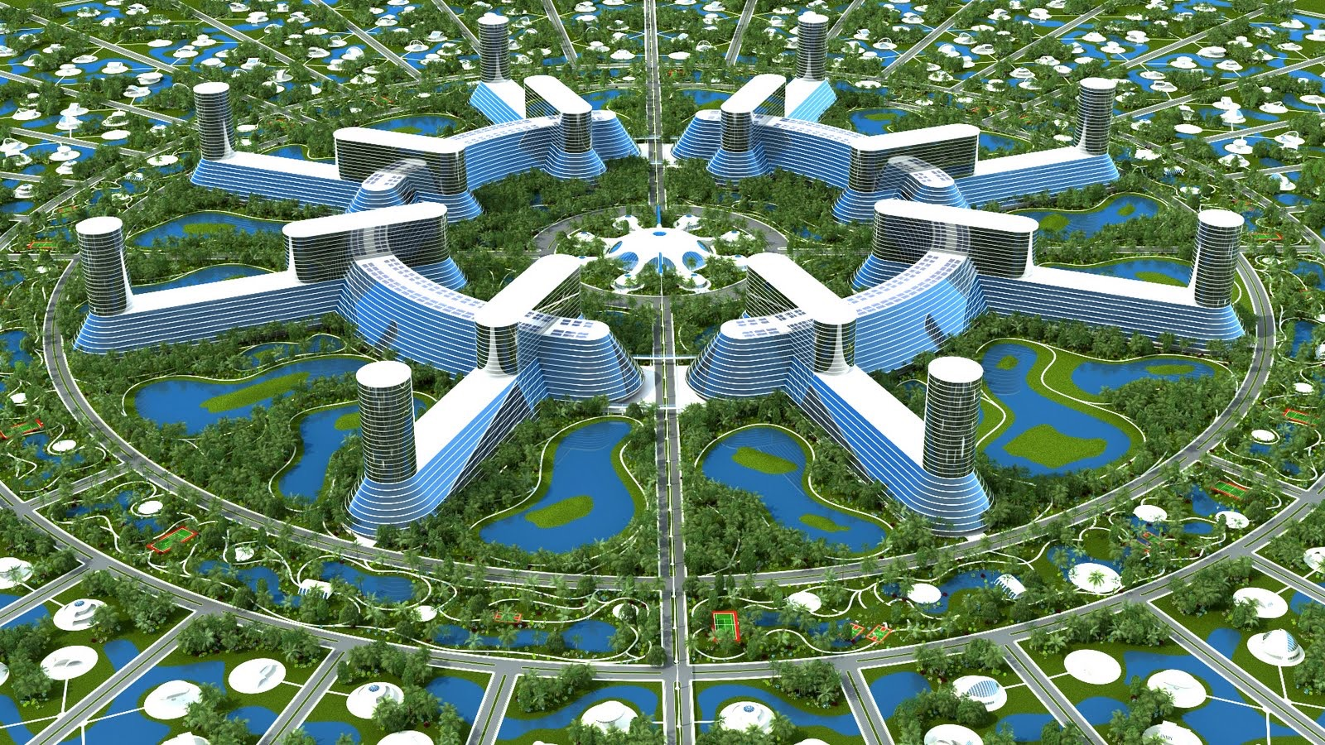
Tech heaven?

Slide 9
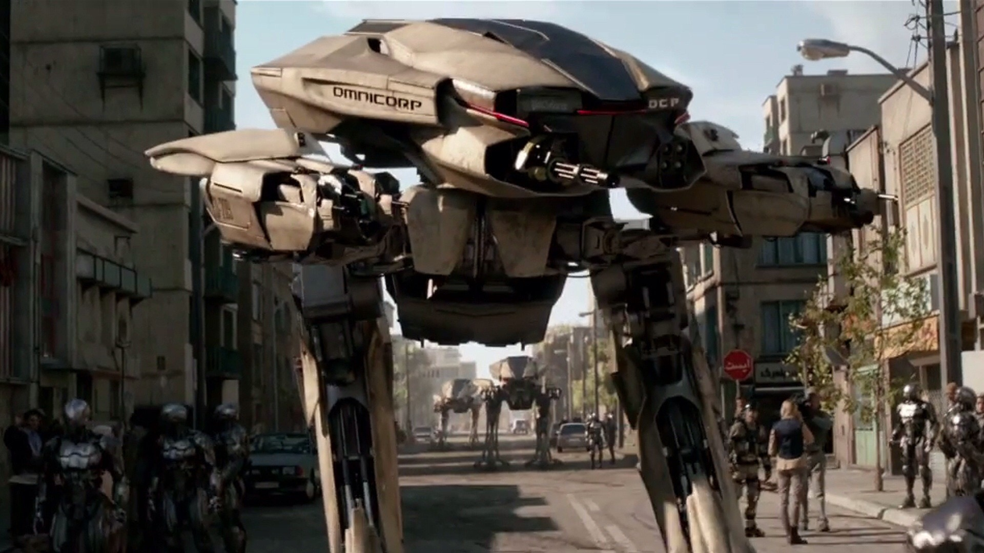
Tech hell?

Slide 10

Human extinction?

Slide 11
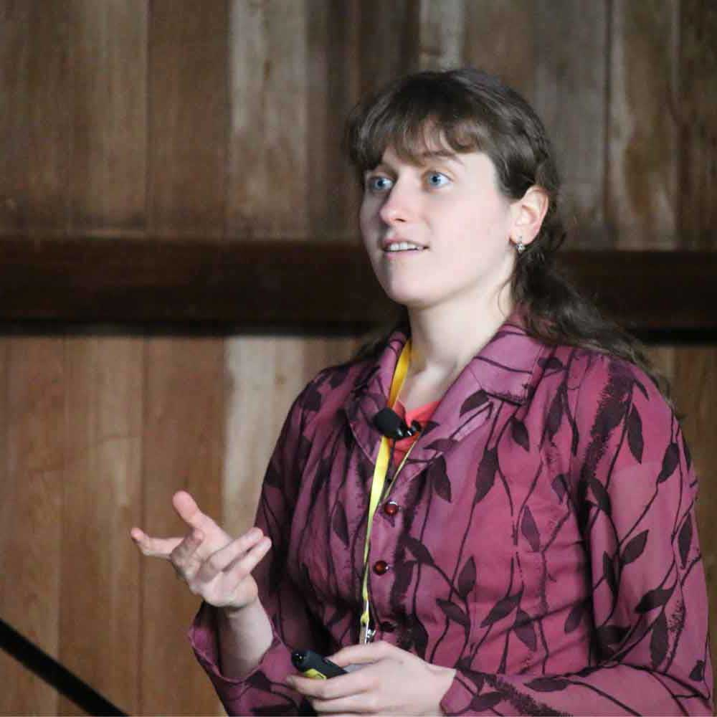
Who’s working on it?

Slide 12
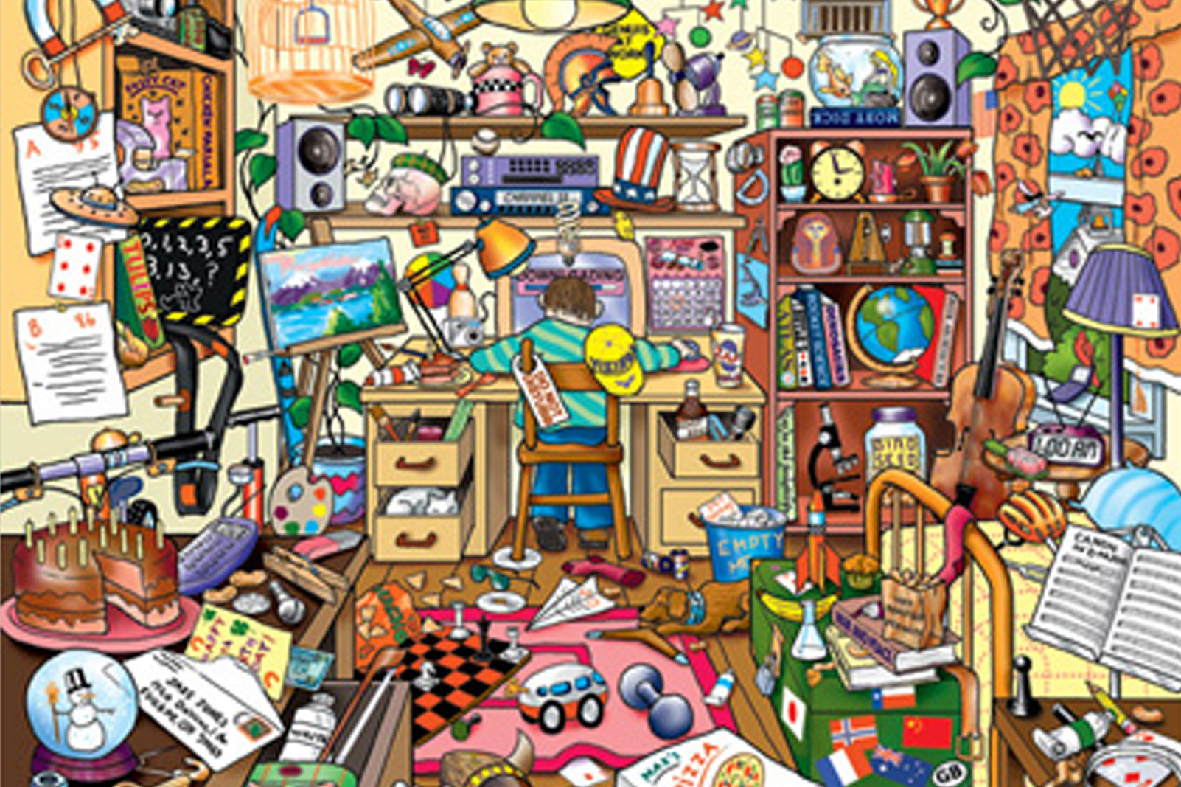
Remember… the world is messy

Slide 13
What should you do?
Expect big changes
Learn more: WaitButWhy on Artificial Intelligence
Join the conversation

